Slide 1

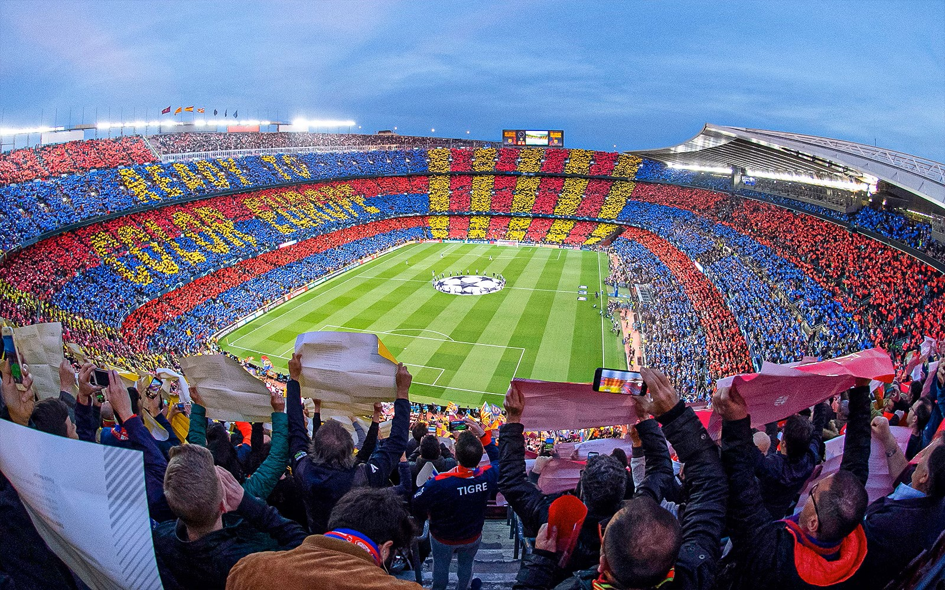

Slide 2
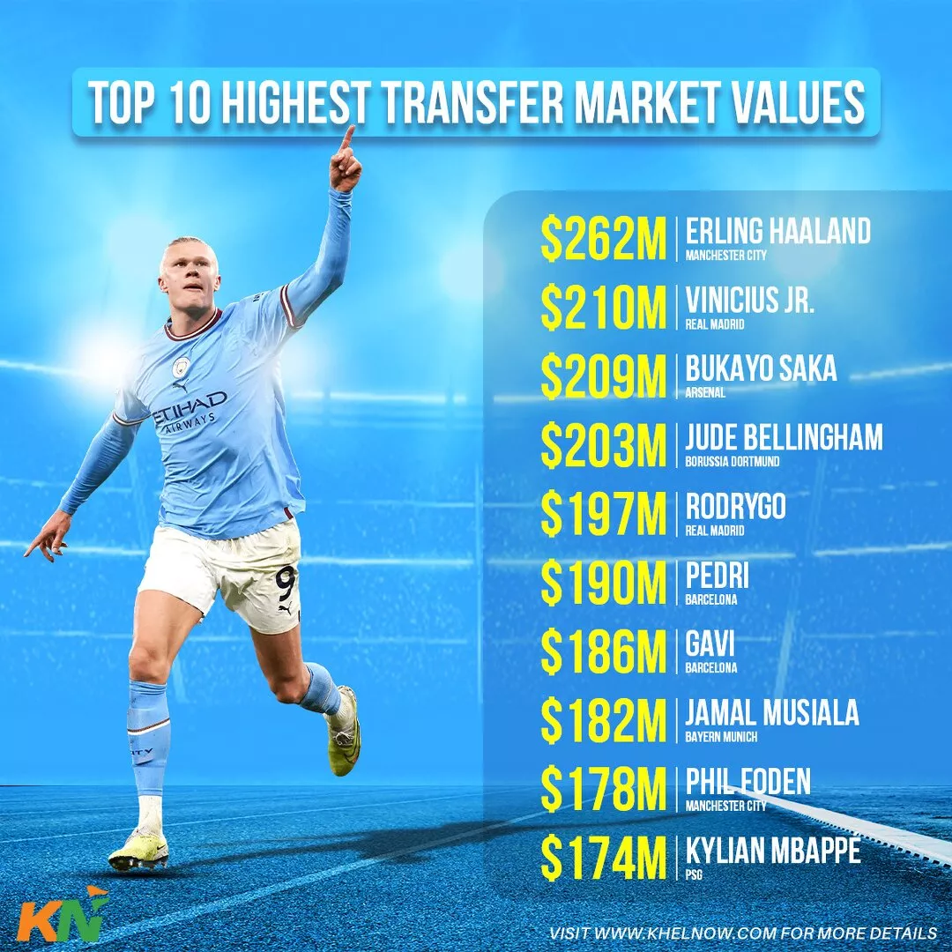
PRESENTATION
ON
TRANSFERMASTER

Slide 3


TEAM MEMBERS
DURGA BUDHA (S.N.321010)
PRAJJWAL MAHARJAN (S.N.321021)
RABIN PULAMI MAGAR (S.N.321026)

Slide 4
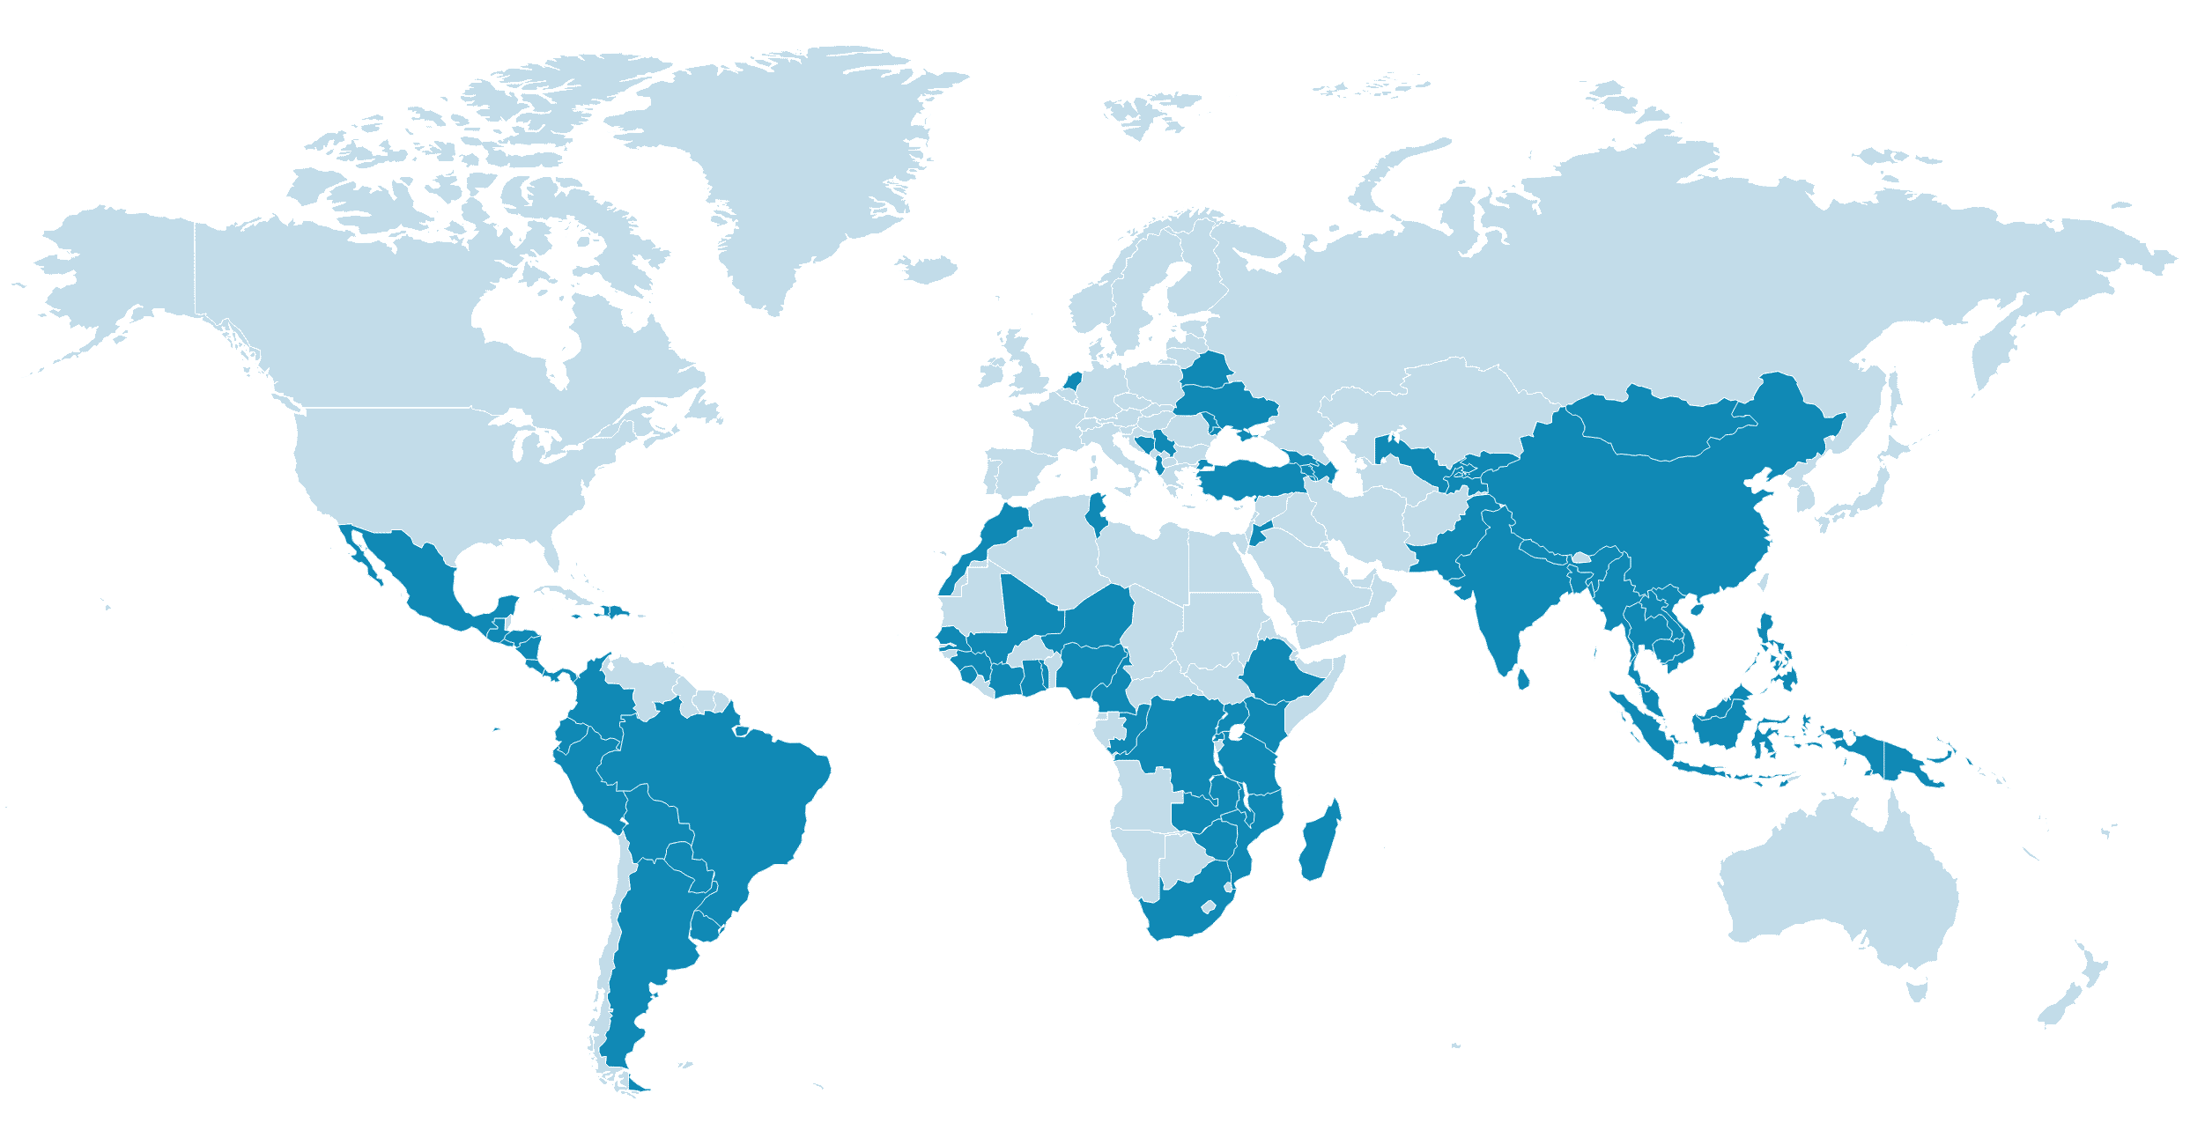

TRASNFERMASTER
Demo
Basic Concept
7.
1.
Conclusion
6.
2.
Applications
Future Prospect
5.
3.
Key Features
CONTENT
4.
Objectives

Slide 5
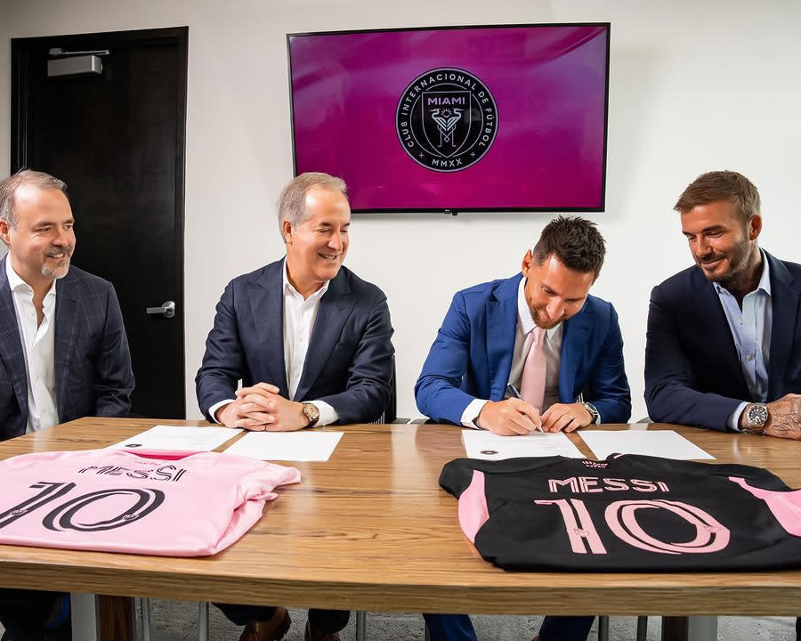
Basic Concept
What is TransferMaster?
Based on C++ programming Language
Designed to meet modern management of player transfer between clubs and predict players performances
Helps to strengthen club squad for club competition
Helps in club businesses accurately and efficiently
Included for both admin and client
Holds the record of player transfer in club

Slide 6
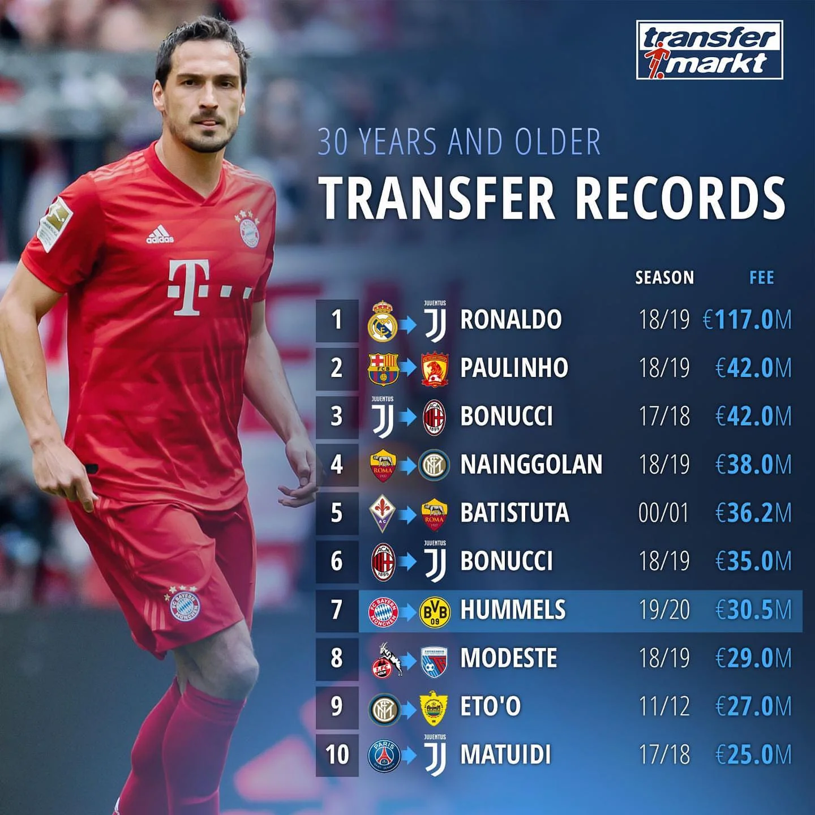
Applications
What are the applications?
Transfer negotiation and contracts: Tracks contract details, expiration dates, and negotiations
Player Rating : Store players statistics and rates the player
Financial Budgeting: Ensures compliance with Financial Fair Play (FFP) regulations
Leagues: To regulate and oversee player transfers
Scouting & Recruitment: Helps clubs find and compare potential signings.

Slide 7
Key Features
Client/server Architecture
Data-Driven Predictions
Both admin and client can use login , signup and update password feature
Utilizes extensive performance statistics and market trends to generate accurate player ratings and transfer values.
Performance Analysis
Market Trend Analysis
Analyzes player performance metrics to provide a comprehensive evaluation of player capabilities.
Monitors market trends to adjust transfer values, reflecting the current market conditions.

Slide 8
Key Features
Data-Driven Predictions
Utilizes extensive performance statistics and market trends to generate accurate player ratings and transfer values.
Client/server Architecture
Both admin and client can use login , signup and update password feature
Performance Analysis
Market Trend Analysis
Analyzes player performance metrics to provide a comprehensive evaluation of player capabilities.
Monitors market trends to adjust transfer values, reflecting the current market conditions.

Slide 9
Key Features
Client/server Architecture
Both admin and client can use login , signup and update password feature
Data-Driven Predictions
Utilizes extensive performance statistics and market trends to generate accurate player ratings and transfer values.
Performance Analysis
Market Trend Analysis
Analyzes player performance metrics to provide a comprehensive evaluation of player capabilities.
Monitors market trends to adjust transfer values, reflecting the current market conditions.

Slide 10
Key Features
Client/server Architecture
Data-Driven Predictions
Utilizes extensive performance statistics and market trends to generate accurate player ratings and transfer values.
Both admin and client can use login , signup and update password feature
Performance Analysis
Analyzes player performance metrics to provide a comprehensive evaluation of player capabilities.
Market Trend Analysis
Monitors market trends to adjust transfer values, reflecting the current market conditions.

Slide 11
Key Features
Client/server Architecture
Data-Driven Predictions
Utilizes extensive performance statistics and market trends to generate accurate player ratings and transfer values.
Both admin and client can use login , signup and update password feature
Market Trend Analysis
Monitors market trends to adjust transfer values, reflecting the current market conditions.
Performance Analysis
Analyzes player performance metrics to provide a comprehensive evaluation of player capabilities.

Slide 12
Objectives
Predict/Analysis
Strengthen squad
To provide accurate player ratings and future performances based on statistical analysis
To manage and maintain strong squad for the club competition
Financial Gain
Club Development
To generate revenue by selling players to another club or balance wages
To increases the popularity within nationwide and attract star players to boost global viewership

Slide 13
Objectives
Strengthen squad
To manage and maintain strong squad for the club competition
Predict/Analysis
To provide accurate player ratings and future performances based on statistical analysis
Financial Gain
Club Development
To generate revenue by selling players to another club or balance wages
To increases the popularity within nationwide and attract star players to boost global viewership

Slide 14
Objectives
Predict/Analysis
To provide accurate player ratings and future performances based on statistical analysis
Strengthen squad
To manage and maintain strong squad for the club competition
Financial Gain
Club Development
To generate revenue by selling players to another club or balance wages
To increases the popularity within nationwide and attract star players to boost global viewership

Slide 15
Objectives
Predict/Analysis
Strengthen squad
To provide accurate player ratings and future performances based on statistical analysis
Utilizes extensive performance statistics and market trends to generate accurate player ratings and transfer values.
Financial Gain
To generate revenue by selling players to another club or balance wages
Club Development
To increases the popularity within nationwide and attract star players to boost global viewership

Slide 16
Objectives
Predict/Analysis
Strengthen squad
To provide accurate player ratings and future performances based on statistical analysis
Utilizes extensive performance statistics and market trends to generate accurate player ratings and transfer values.
Club Development
To increases the popularity within nationwide and attract star players to boost global viewership
Financial Gain
To generate revenue by selling players to another club or balance wages

Slide 17

Future Prospect
1.
Increased Data-Driven Decisions
2.
Mobile Application Development
3.
Rise of Multi-club Ownership
4.
Transfer Market Inflation and Regulation
5.
AI and Digital Scouting

Slide 18
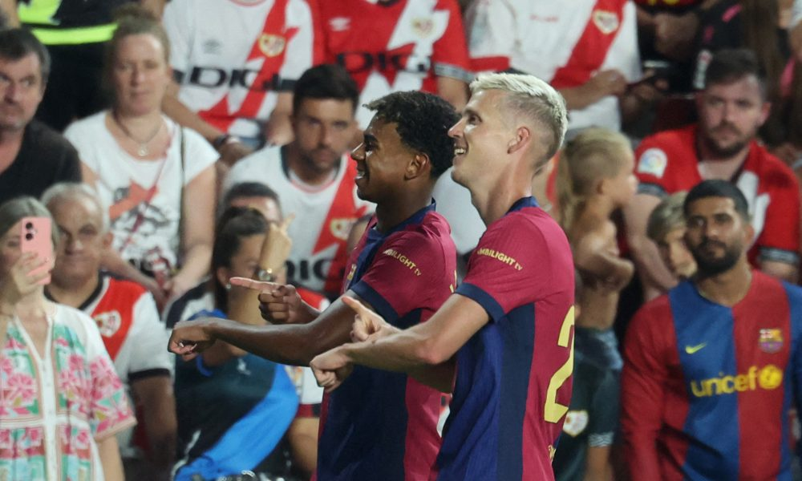
Conclusion
1.
User-friendly Interface
2.
Regression-Based Player Rating and Transfer Fee Calculation
3.
Efficient Transfer Management
4.
Innovation in Transfer Strategy
5.
Economic Stability of Club

Slide 19
DEMO
OF
TRANSFERMASTER

Slide 20
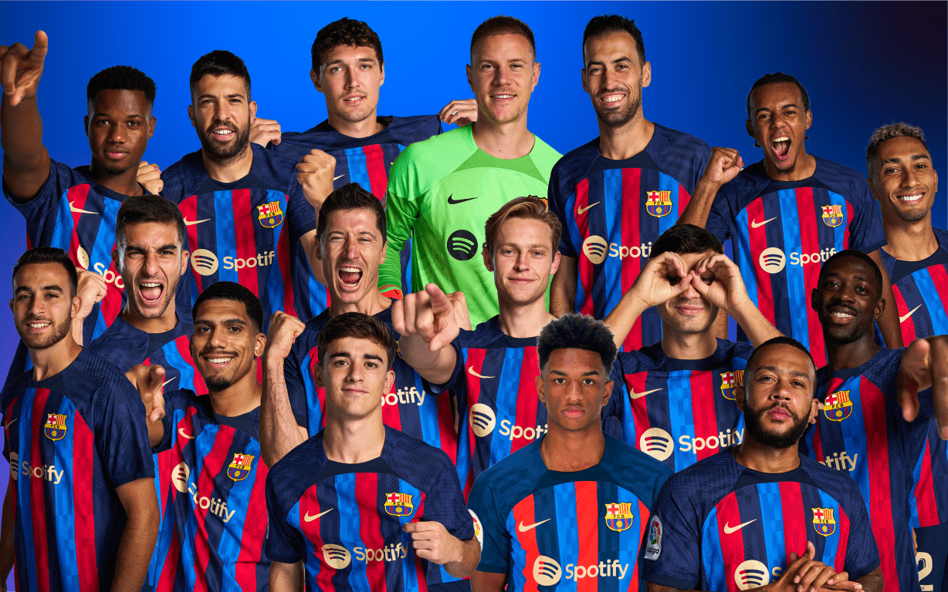
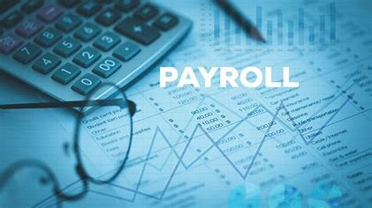
Thank You
Do you have any queries?

